Slide 1

ARKA JAIN UNISERSITY
Loan Approval Data Insights Dashboard
PRESENTED BY- TASNEEM FATMA
ENROLLMENT NUMBER-AJU/251167

Slide 2
INDRODUCTION
The Loan Approval Data Insights Dashboard provides a clear view of loan applications, borrower profiles, and approval trends. It helps identify risk factors, analyze creditworthiness, and improve decision-making. With interactive visuals and key metrics, the dashboard supports efficient, transparent, and data-driven loan approval processes.

Slide 3
Key Dashboard Components
Total Loan Application
Average Credit Score
Total Loan Amount
Investment Goals
Interest Rate by Risk Tolerance

Slide 4
Dashboard Visualization
Visual 1: Age by loan status
Type : Line and Stacked Column Chart
Visual 2:loan term by employment status
Type : waterfall chart
Visual 3: total loan amount by loan purpose
Type : pie chart
Visual 4:Age by investment
Type :line and clustered column chart
Visual 5: interest rate by risk tolerant
Type : Donut chart
Visual 6: Unique occupation
Type : Gauge

Slide 5
Benefits of a Loan Approval Insights
Improved decision-making
Increased operational efficiency
Better Risk Assessment
Enhanced Customer Experience
Transparency in loan Evolution
Strategic Business Planning

Slide 6
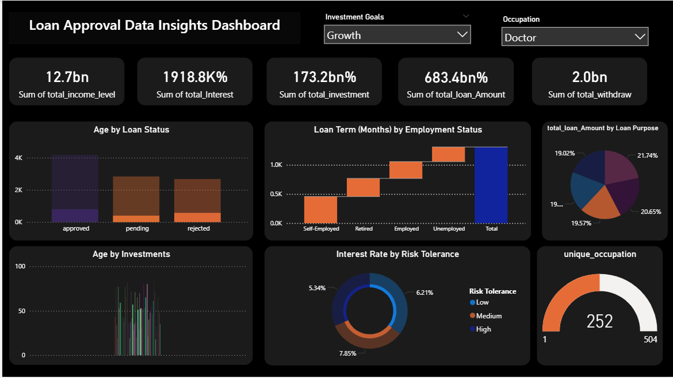
Dashboard

Slide 7
Conclusion
The Loan Approval Data Insights Dashboard enables smarter, faster, and more transparent lending decisions by analyzing borrower profiles, creditworthiness, and risk patterns. It improves operational efficiency, reduces default rates, and empowers financial institutions to optimize loan strategies, ensuring a reliable and data-driven approval process that enhances overall business performance.

